Slide 1
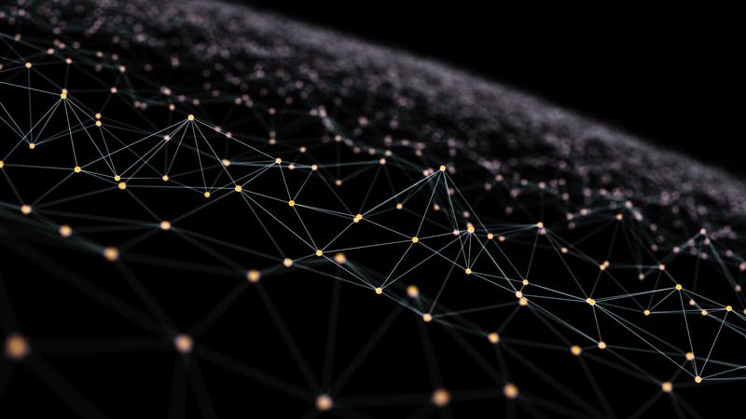
Neural Networks
an alternate form of computation

Slide 2
Limitations of current forms of computation
Cobham’s Thesis introduced the concept of “intractability”.
This indicates that while algorithms may exist for solving computational problems, the amount of computational and memory resources needed to solve them is impractical.
We have seen many such problems in the NP-complete and NP-hard complexity classes.
We have also covered meta-heuristic methods used to solving these problems in an approximate manner which run under practical limits.

Slide 3
Limitations of current forms of computation
In this section, we will explore 2 alternative forms of computation which can also be used to solve problems by applying a different kind of ‘computational’ logic:
Neural networks
DNA computing

Slide 4
What is a neural network?
A Neural Network is a computer system that is modelled on the human brain and/or nervous system.
It generally works by having a series of nodes, networked together so that an input at one node results in a propagation of the signal through the network until reaching the output node.
For the purposes of Algorithmics, Neural Networks can be considered to be a bit like a black box...

Slide 5
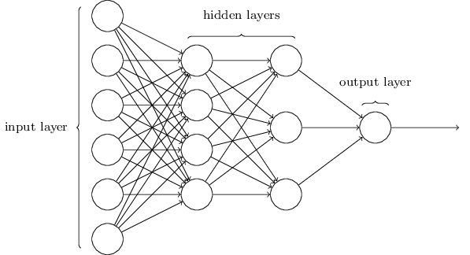

The Black Box Model

Slide 6
The Black Box Model
A typical application of Neural Networks is to solve classification problems (e.g. image recognition, voice detection etc.)
A large number of inputs are applied to the input layer. The results of each input is fed into the black box and the output layer identifies the image.

Slide 7
The Black Box Model
These neural networks often have to be “TRAINED”.
That is to say, before they are made available for wider use, they are given data sets which test if the given input results in the correct output.
When the result is not correct, the black box components are tweaked to give better outputs until the black box becomes reliable.

Slide 8

So what is going on inside the black box?

Slide 9
Inside The Black Box

Slide 10
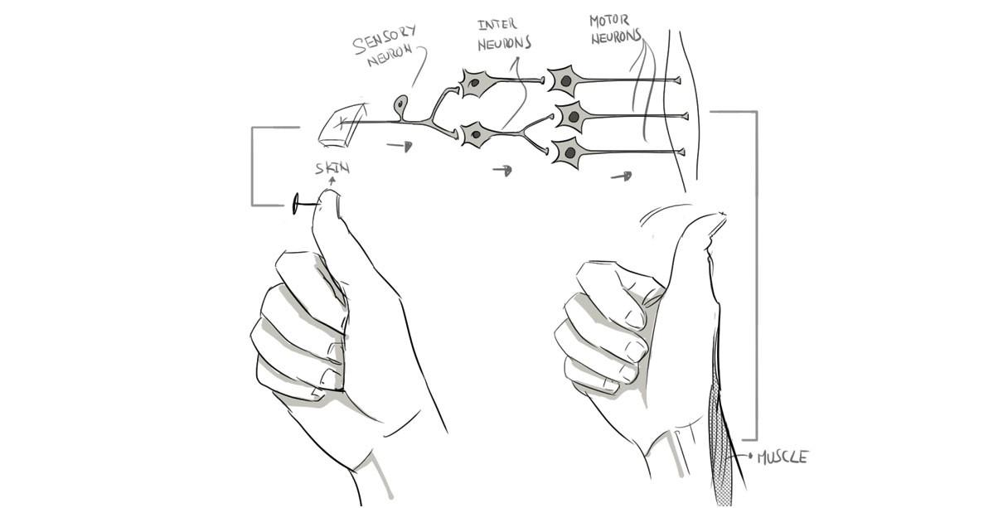
Inside The Black Box

Slide 11
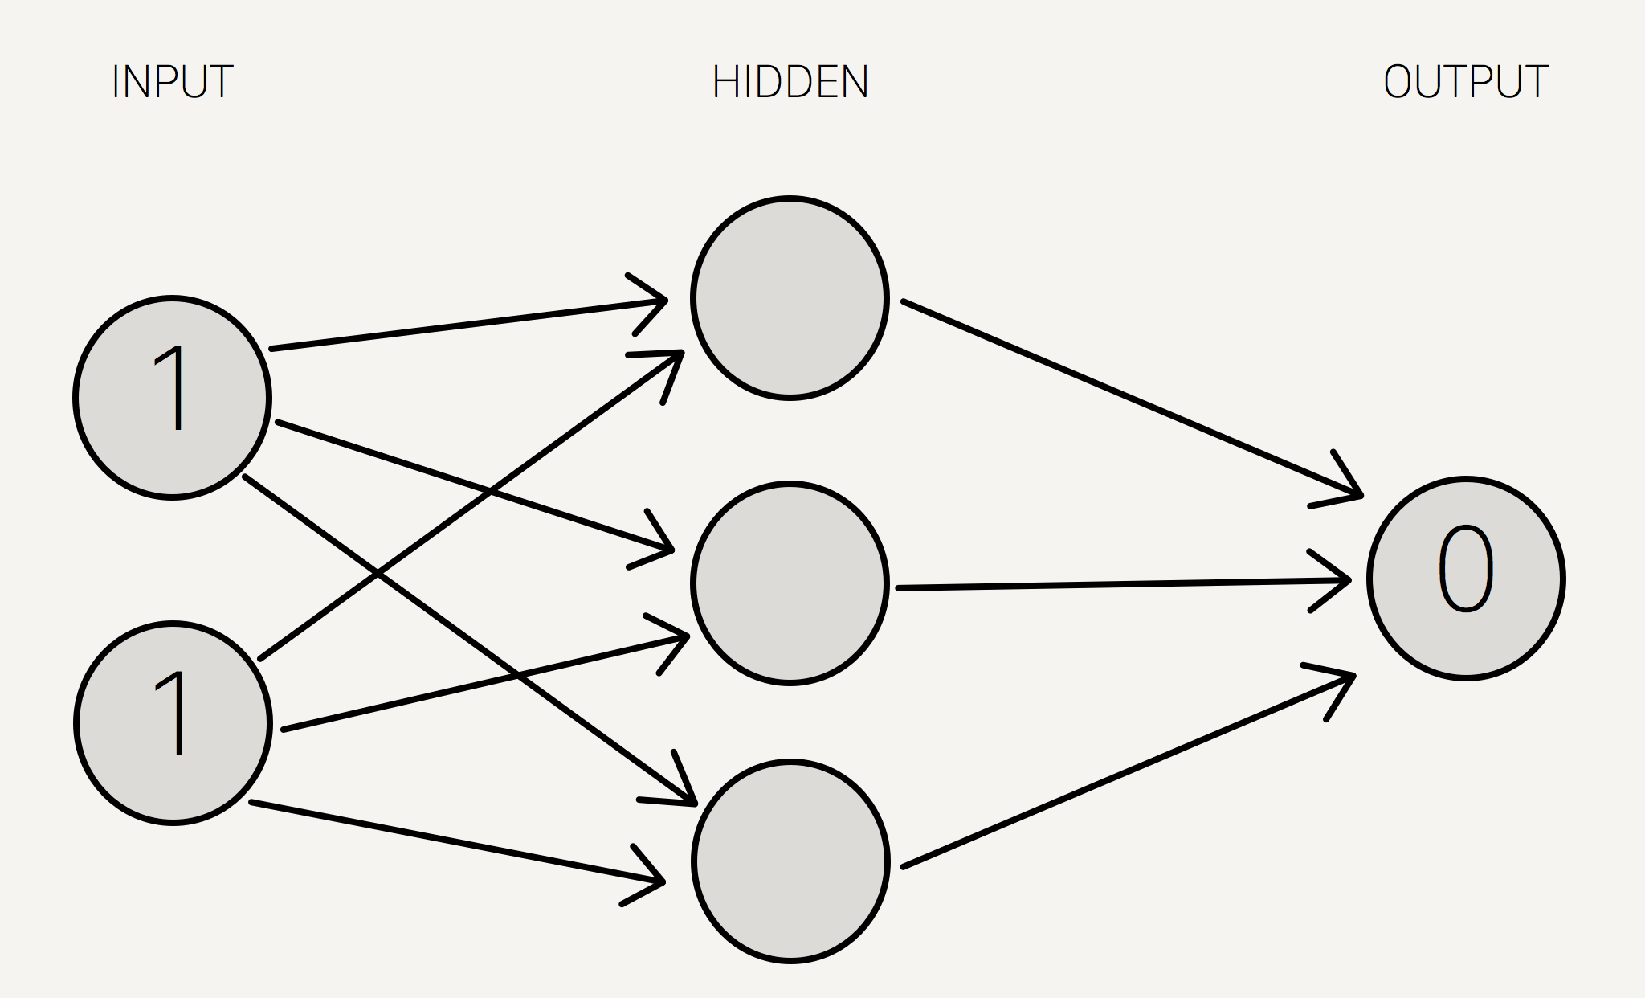
An example of XOR

Slide 12
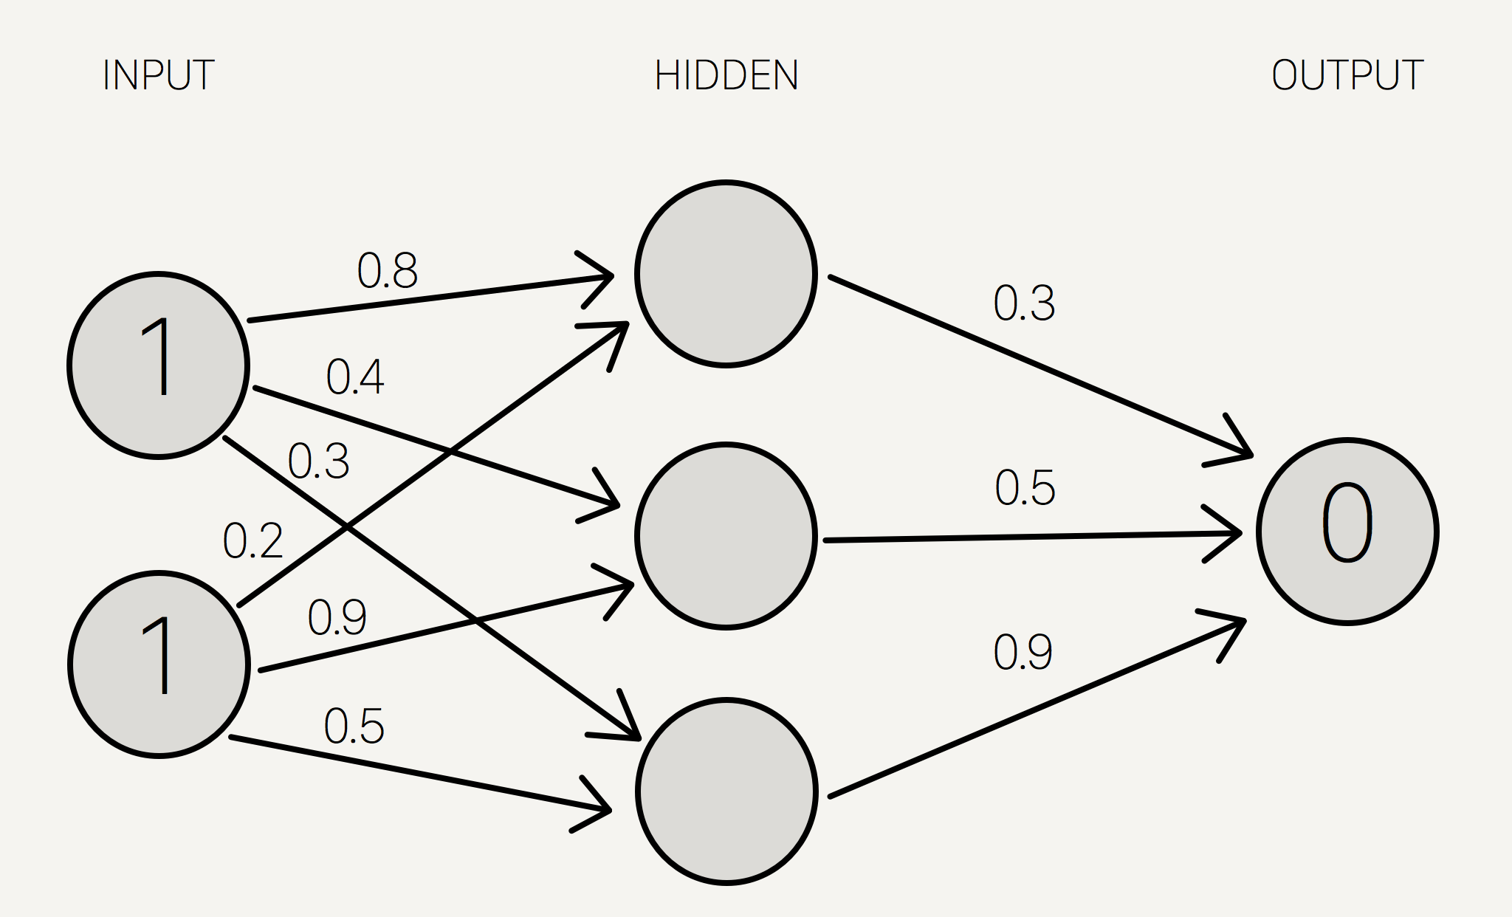
An example of XOR

Slide 13
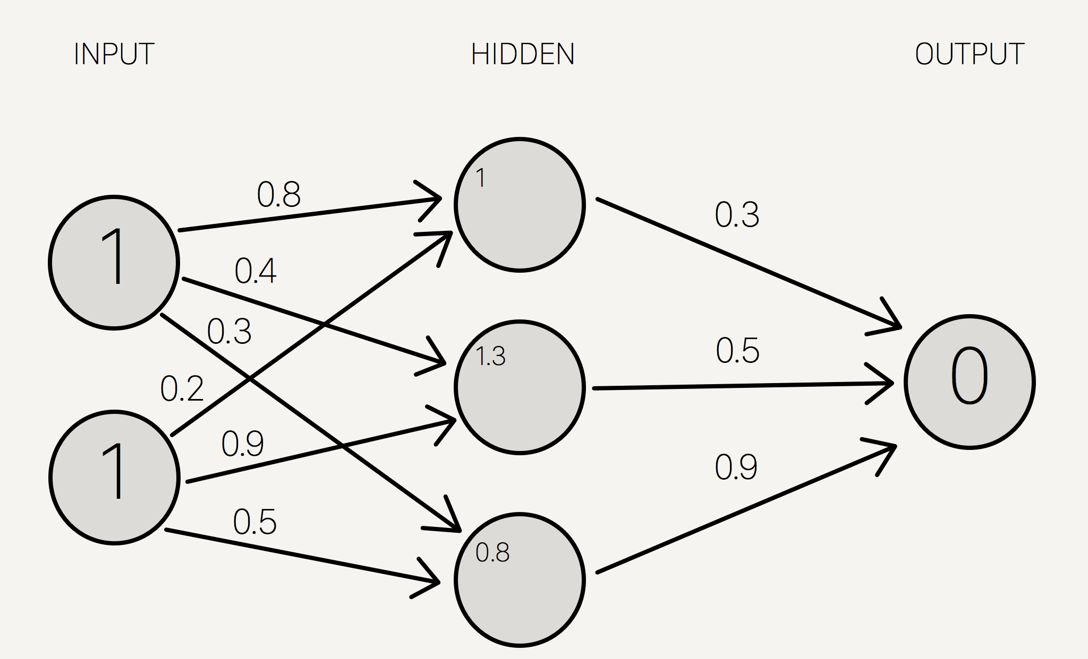
An example of XOR

Slide 14
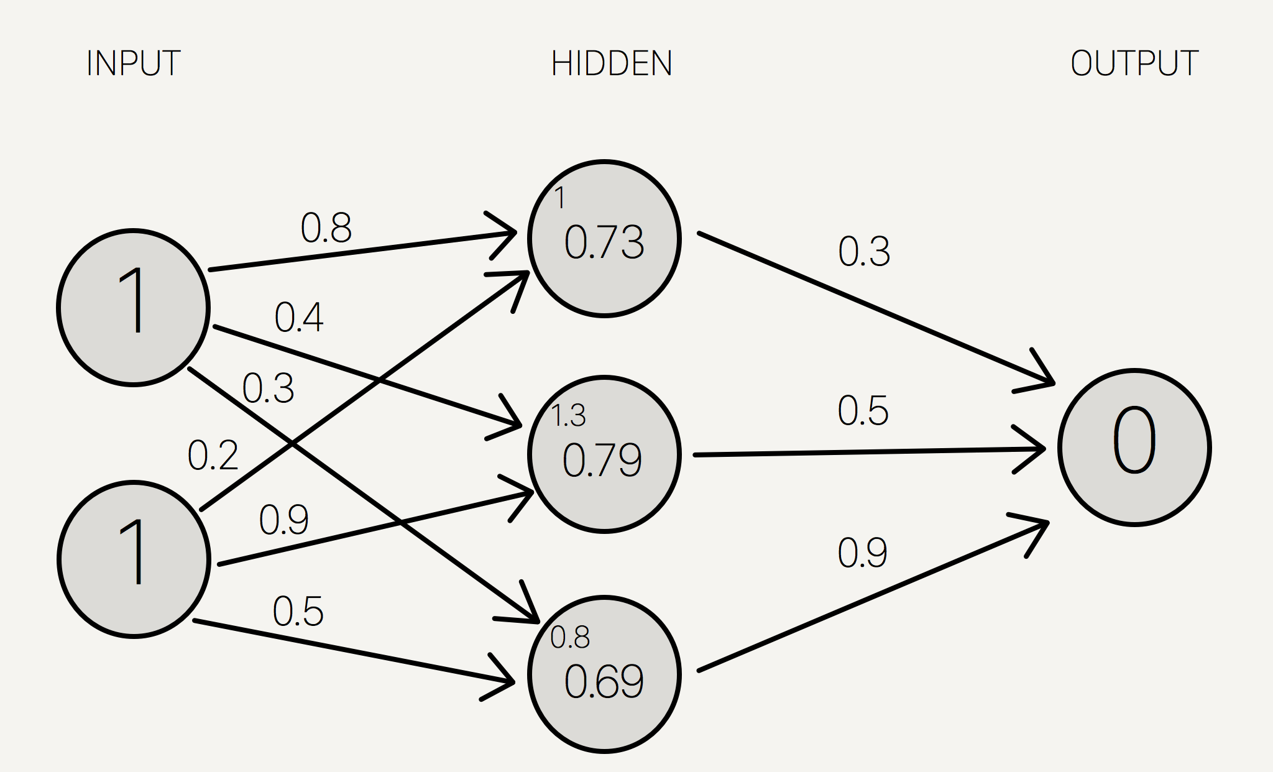
An example of XOR

Slide 15
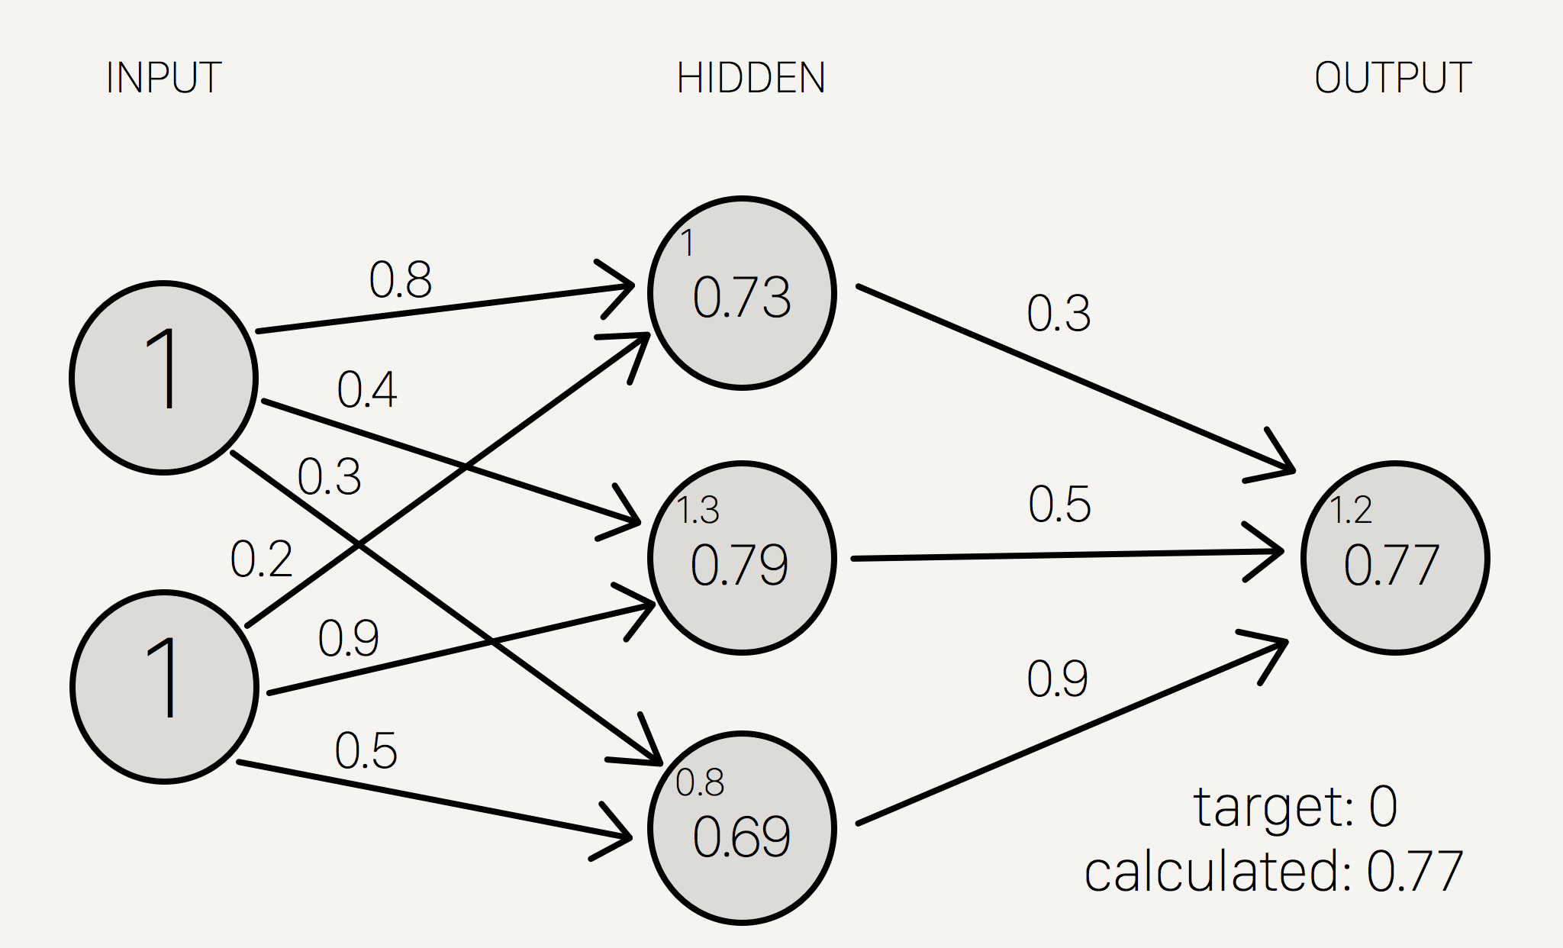
An example of XOR
This process is known as forward propogation

Slide 16
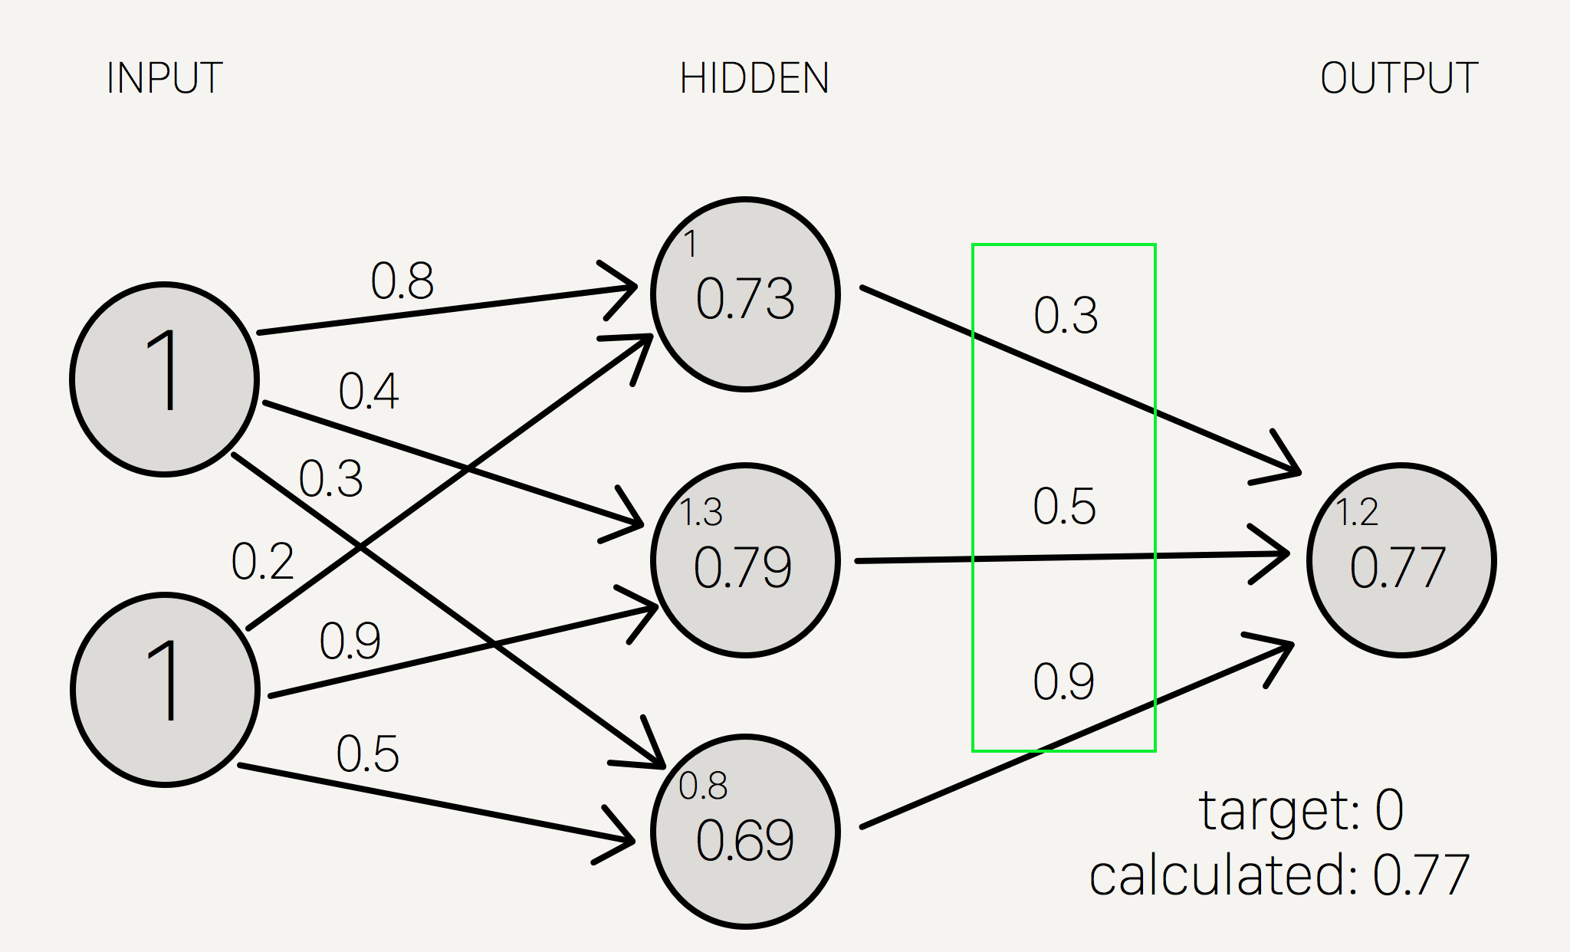
An example of XOR
We can then use back propogation to improve upon the result

Slide 17
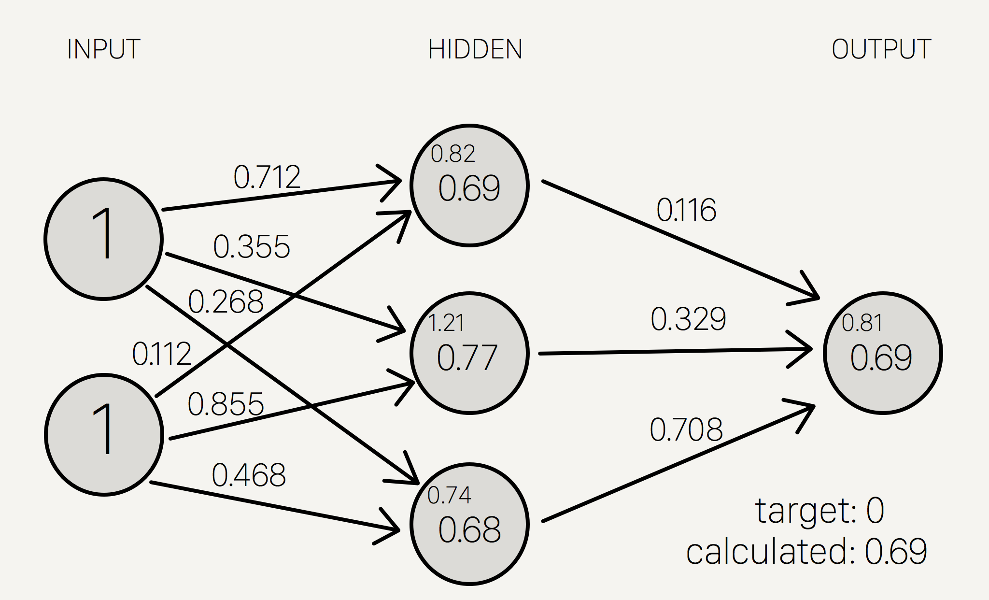
An example of XOR

Slide 18
So what do you need to know?
Neural Networks work by taking specific inputs as signals which then lead to a propogation of the signal through a weighted network graph to produce a specific output.
Neural Networks undergo what is known as ‘machine learning’ where the network is trained on a given data set and the weightings of the graph are modified (either through back propagation or forward propagation) to improve the accuracy of the outputs.
They are different to traditional algorithmic approaches because they can’t really be written down in the same line-by-line manner like the other algorithms we have investigated in this course.
Training data for neural networks need to be carefully chosen to avoid bias in the network.

